Slide 1
Algorithms
Sorting
March 2020

Slide 2
What is sorting?
Stable sorting
Comparison sort algorithms
Non-comparison sort algorithms
Conclusion

Slide 3
What is sorting?
Part 1
Sorting is any process of arranging items in some sequence. From Wikipedia, the free encyclopedia
We take some elements and place them in some order.

Slide 4
What is sorting?
Part 2
But why sorting?
Searching in sorted sequence is faster.
Some algorithms only work on a sorted sequence.
Sometimes generating the results in a pre-specified order is a requirement(e.g. when we write a dictionary).

Slide 5
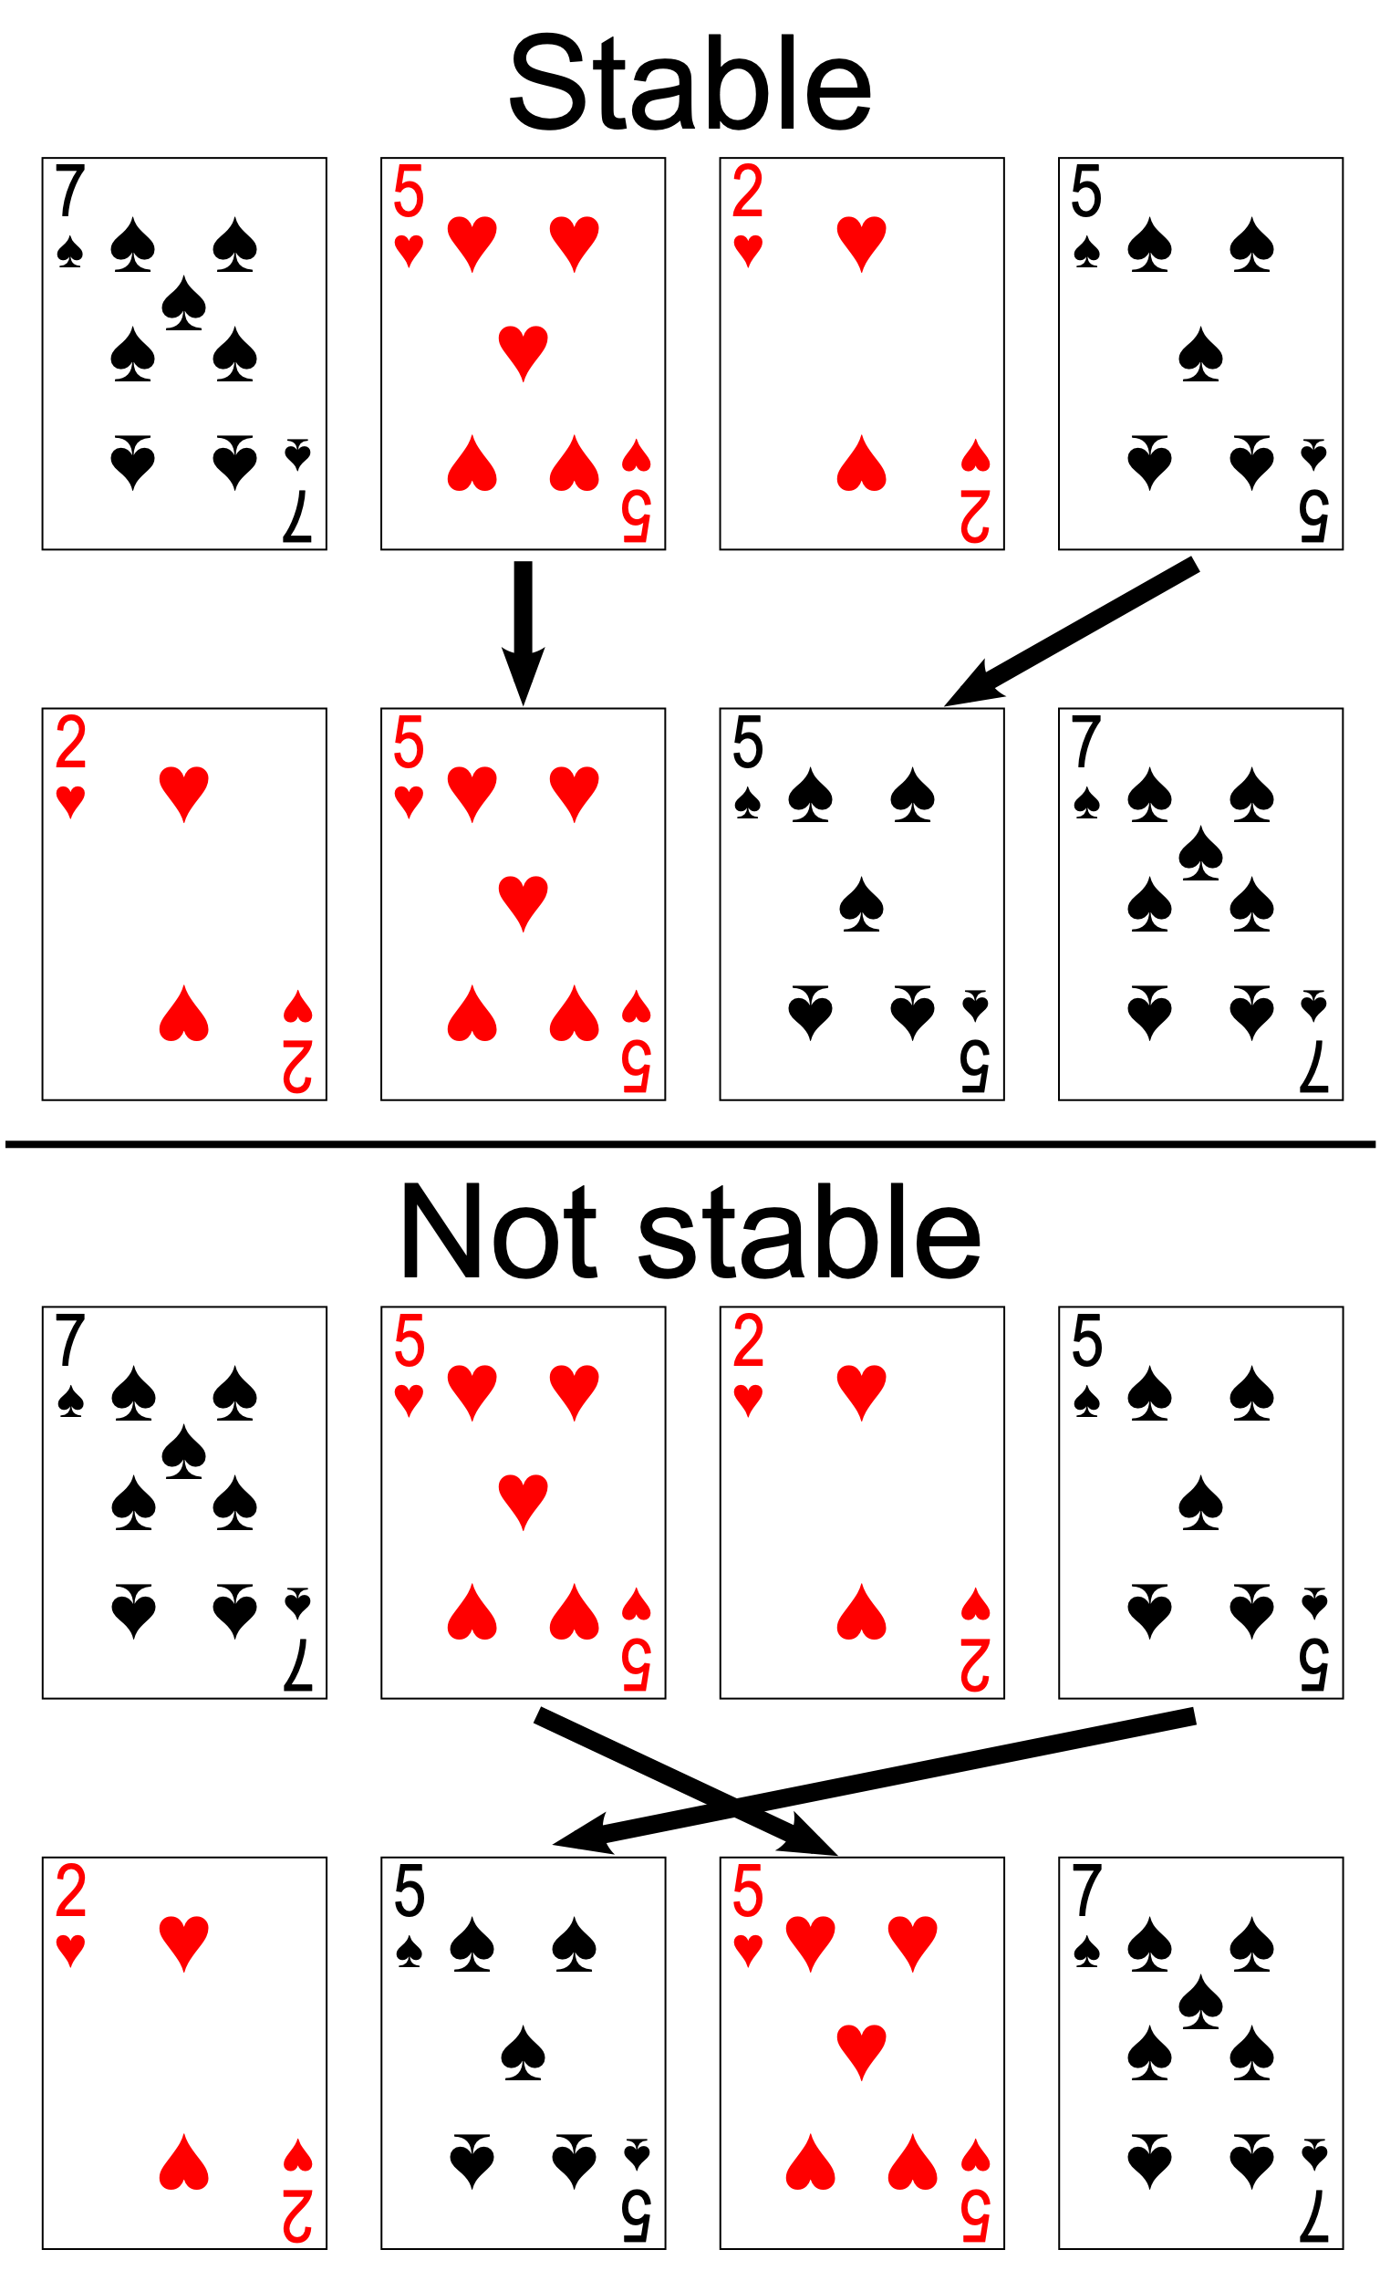
Stable sorting
A sorting algorithm arranges elements according to some comparison.
A stable sorting algorithm will not change the places of elements that are equal according to the comparison.

Slide 6
Comparison sort algorithms
What is a comparison sort algorithm
Best possible computational complexity
Quadratic algorihtms
Better algorithms

Slide 7
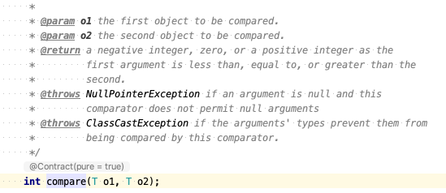
What is comparison sort algorithm
Sorting is performed using a single binary abstract function
We compare two elements
We have only two possible results – smaller or not smaller

Slide 8
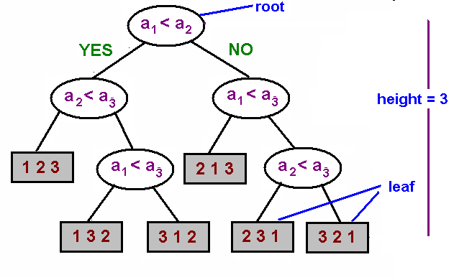
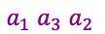
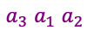
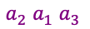
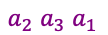
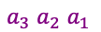
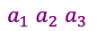
Best possible computation complexity
Part 1
On each step we split the set of possible outcomes using a binary decision.
All possible outcomes are n! (n factorial)
After performing a set of comparisons, we need to have only a single possible outcome – the sorted sequence.
$a_{1}$ $a_{2}$ $a_{3}$
$a_{2}$ $a_{1}$ $a_{3}$
$a_{1}$ $a_{3}$ $a_{2}$
$a_{3}$ $a_{1}$ $a_{2}$
$a_{2}$ $a_{3}$ $a_{1}$
$a_{3}$ $a_{2}$ $a_{1}$

Slide 9
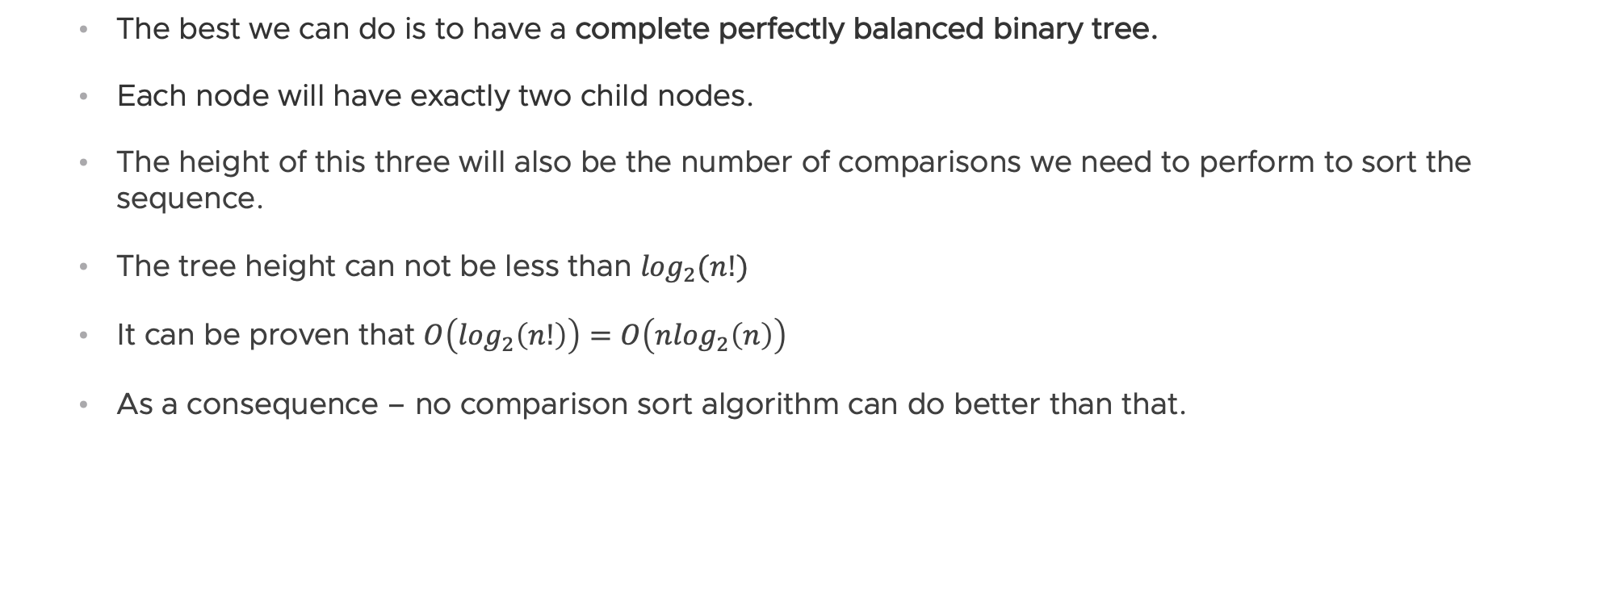
Best possible computation complexity
Part 2
The best we can do is to have a complete perfectly balanced binary tree.
Each node will have exactly two child nodes.
The height of this three will also be the number of comparisons we need to perform to sort the sequence.
The tree height can not be less than $\log_{2}(n!)$
It can be proven that $O\left(\log_{2}\left(n!\right)\right)=O\left(n\log_{2}\left(n\right)\right)$
As a consequence – no comparison sort algorithm can do better than that.

Slide 10
Quadratic algorithms
Bubble sort
Selection sort
Insertion sort

Slide 11
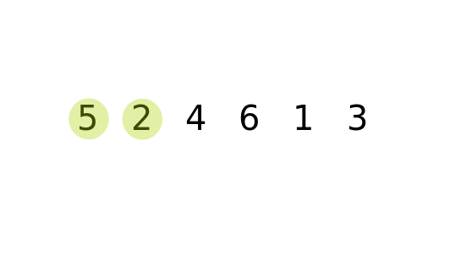
Bubble sort
Part 1
boolean swapped = false;
do {
swapped = false;
for (int i = 0; i + 1< n; ++i) {
if (a[i + 1] < a[i]) {
swap(a[i], a[i + 1]); // NOT valid java.
swapped = true;
}
}
} while (swapped);
A big element “pops-up” really fast, but small elements “sinks” slowly.

Slide 12
Bubble sort
Part 2
Possible optimizations:
On each iteration swap the direction – left to right or right to left. This will solve the “slow sinking” issue(Cocktail sort).
Compare with bigger gaps and gradually reduce them(Comb sort).

Slide 13
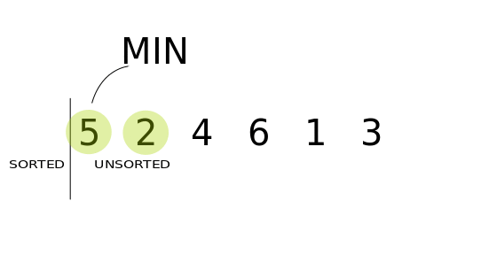
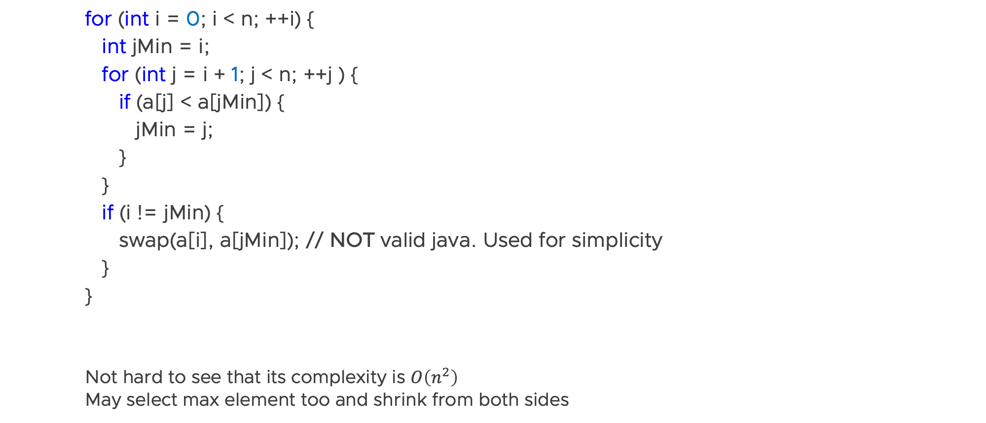
Selection sort
for (int i = 0; i < n; ++i) {
int jMin = i;
for (int j = i + 1; j < n; ++j ) {
if (a[j] < a[jMin]) {
jMin = j;
}
}
if (i != jMin) {
swap(a[i], a[jMin]); // NOT valid java. Used for simplicity
}
}
Not hard to see that its complexity is $O\left(n^{2}\right)$ May select max element too and shrink from both sides

Slide 14
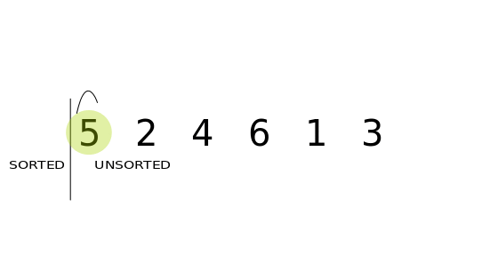
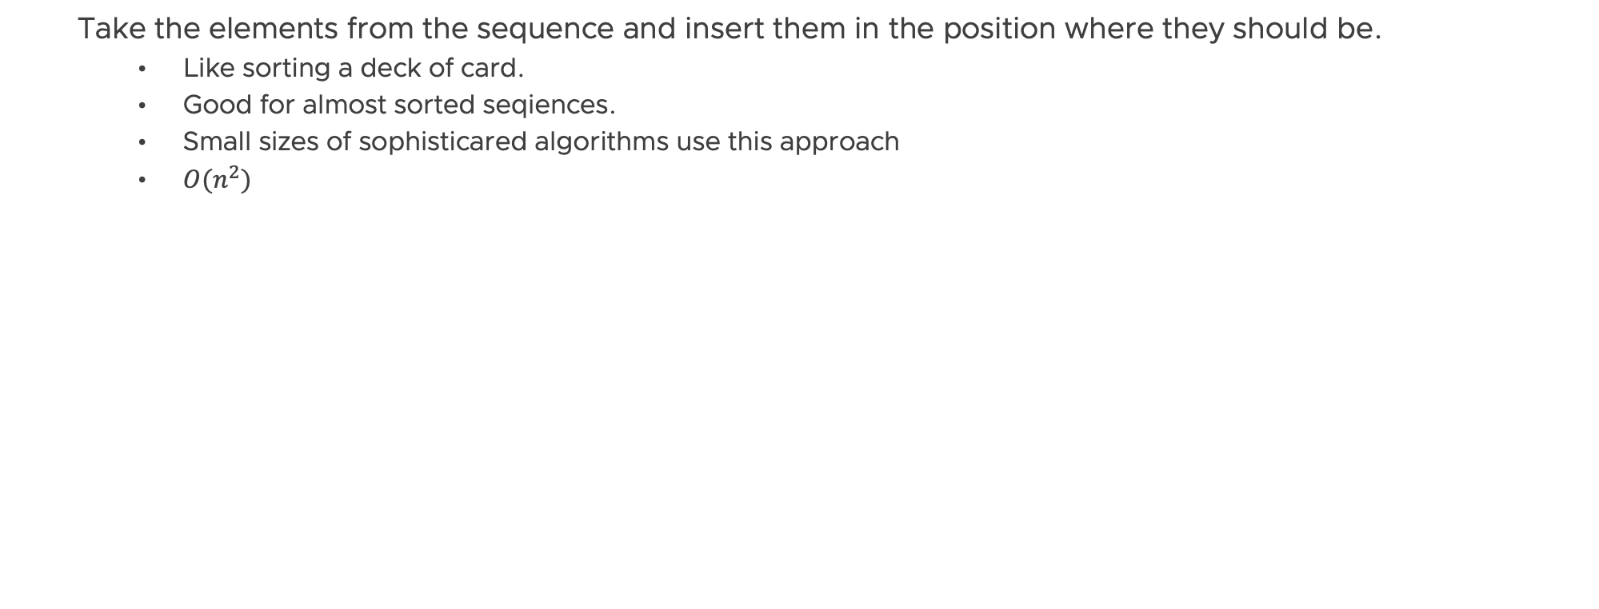
Inserion sort
Take the elements from the sequence and insert them in the position where they should be.
Like sorting a deck of card.
Good for almost sorted seqiences.
Small sizes of sophisticared algorithms use this approach
$O(n^{2})$

Slide 15
Exercise
Implement Selection sort
Use it to implement searching for the nth smallest element.

Slide 16
BREAK

Slide 17
Better algorithms
Merge sort
Quick sort

Slide 18
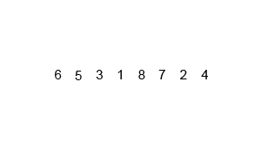
Merge sort
Part 1
Divide and conquer:
Split the sequence in two (almost) equal parts.
Sort the two subsequences.
Merge the resulting sorted subsequences.

Slide 19
Merge sort
Part 2
Pseudo code:
void mergeSort(Sequence a , int size) { if (a.size() < 2) { return; } mergeSort(a.subsequence(0, size / 2)); mergeSort(a. subsequence(size / 2, size – size / 2)); merge(a, 0, size / 2, size); }

Slide 20
Merge sort
Part 3
Merge procedure:
We create an auxiliary container
While there are elements in at least one of the subsequences
Take the minimal unprocessed element from both sequences
Put the smaller of those into the auxiliary container, mark it processed in the subsequence
Copy contents from the auxiliary container
There is also a version with no additional memory required.

Slide 21
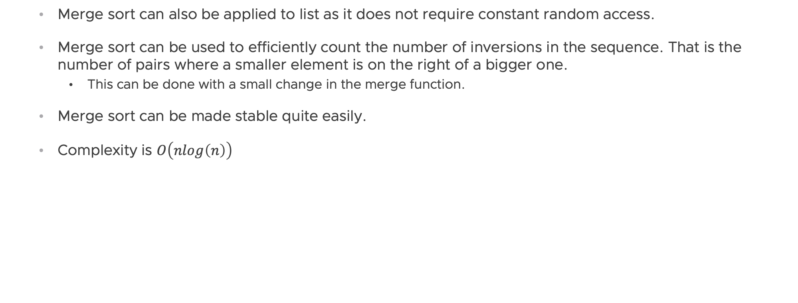
Merge sort
Part 4
Merge sort can also be applied to list as it does not require constant random access.
Merge sort can be used to efficiently count the number of inversions in the sequence. That is the number of pairs where a smaller element is on the right of a bigger one.
This can be done with a small change in the merge function.
Merge sort can be made stable quite easily.
Complexity is $O\left(nlog\left(n\right)\right)$

Slide 22
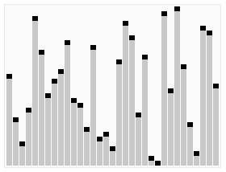
Quick sort
Part 1
Select a value called pivot
Put all values smaller than the pivot on its left and all greater values on its right
Recursively sort the left and the right subsequences.

Slide 23
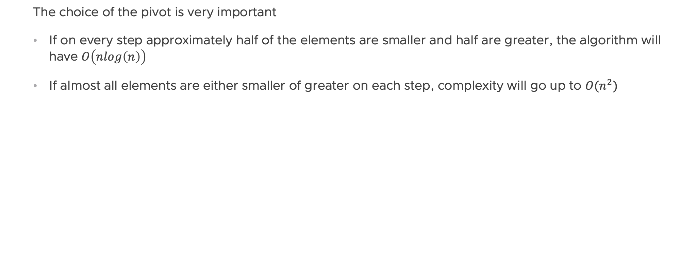
Quick sort
Part 2
The choice of the pivot is very important
If on every step approximately half of the elements are smaller and half are greater, the algorithm will have $O\left(nlog\left(n\right)\right)$
If almost all elements are either smaller of greater on each step, complexity will go up to $O(n^{2})$

Slide 24
Quick sort
Part 3
How to choose the pivot?
The first value in the subsequence we are sorting – problems with already sorted sequences.
A random index element.
The middle element from the subsequence.
The median of the first, last and middle element.

Slide 25
Quick sort
Part 4
Pseudo code: void quickSort(int arr[], int low, int high) { if (low < high) { int pi = partition(arr, low, high); quickSort(arr, low, pi - 1); quickSort(arr, pi + 1, high); } }
int partition (int arr[], int low, int high) { int pivot = choosePivot(arr); int i = (low - 1); for (int j = low; j <= high - 1; j++) { if (arr[j] < pivot) { i++; swap(arr[i], arr[j]); } } swap(arr[i + 1], arr[high]); return (i + 1); }

Slide 26
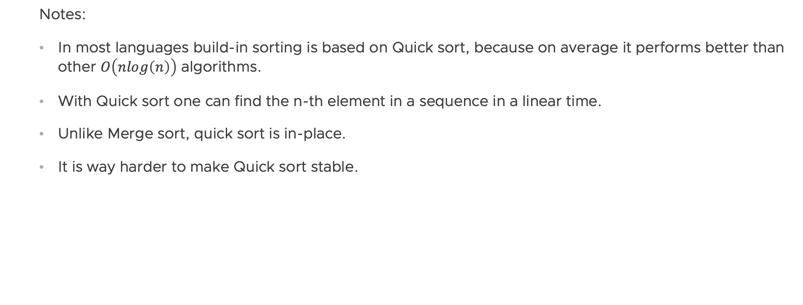
Quick sort
Part 5
Notes:
In most languages build-in sorting is based on Quick sort, because on average it performs better than other $O\left(nlog\left(n\right)\right)$ algorithms.
With Quick sort one can find the n-th element in a sequence in a linear time.
Unlike Merge sort, quick sort is in-place.
It is way harder to make Quick sort stable.

Slide 27
Exercise
You are given an implementation of Quick sort. But there is a bug in it! Using the debugger, find it and fix it!
Then use the partition method to implement finding of the nth smallest element.
Gitlab > Materials-2020 > 03-Data-Structures-and-Algorithms > 03-Sorting > Quick-sort-exercise

Slide 28
BREAK

Slide 29
Non-comparison sort algorithms
What is a non-comparison sort algorithm?
Counting sort

Slide 30
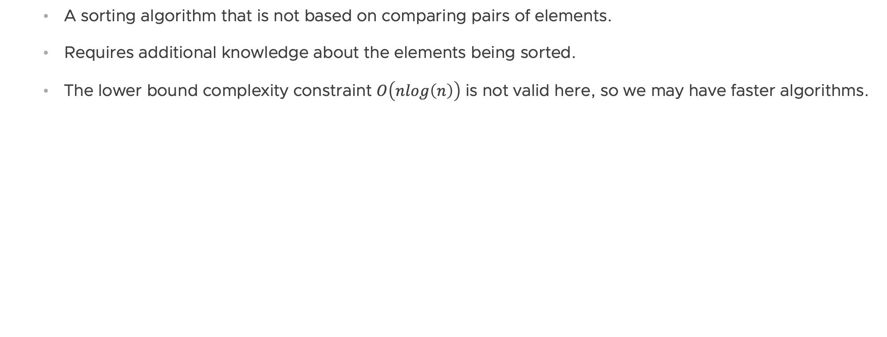
What is a non-comparison sort algorithm?
A sorting algorithm that is not based on comparing pairs of elements.
Requires additional knowledge about the elements being sorted.
The lower bound complexity constraint $O\left(nlog\left(n\right)\right)$ is not valid here, so we may have faster algorithms.

Slide 31
Counting sort
Part 1
Requirement: we know elements can only have m fixed values (known before running the algorithm).
Create an array of size m, where we store the number of each value met in the sequence. Initialize it with zeroes.
Iterate over all elements of the sequence and for each of them increment the counter for the given value in the array.
Iterate over the array and for each value add the respective elements as many times as is the value in the array.

Slide 32
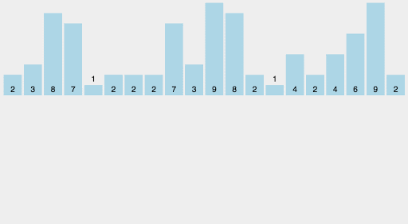
Counting sort
Part 2
Code:
public void countingSort(int[] a, int maxValue) { int counts[] = new int[maxValue +1]; for (int i = 0; i < a.length; ++i) { ++counts[a[i]]; } int index = 0; for (int i = 0; i <= maxValue; ++i) { for (int j = 0; j < counts[i]; ++j) { a[index] = i; index++; } } }

Slide 33
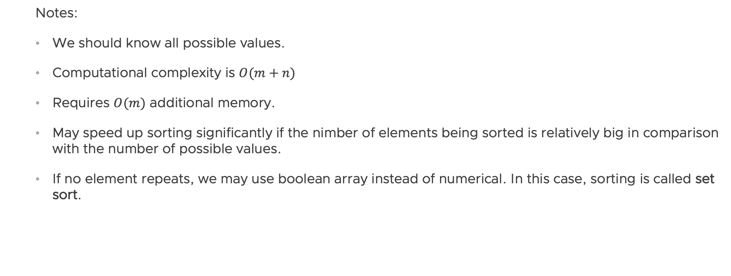
Counting sort
Part 3
Notes:
We should know all possible values.
Computational complexity is $O(m+n)$
Requires $O(m)$ additional memory.
May speed up sorting significantly if the nimber of elements being sorted is relatively big in comparison with the number of possible values.
If no element repeats, we may use boolean array instead of numerical. In this case, sorting is called set sort.

Slide 34
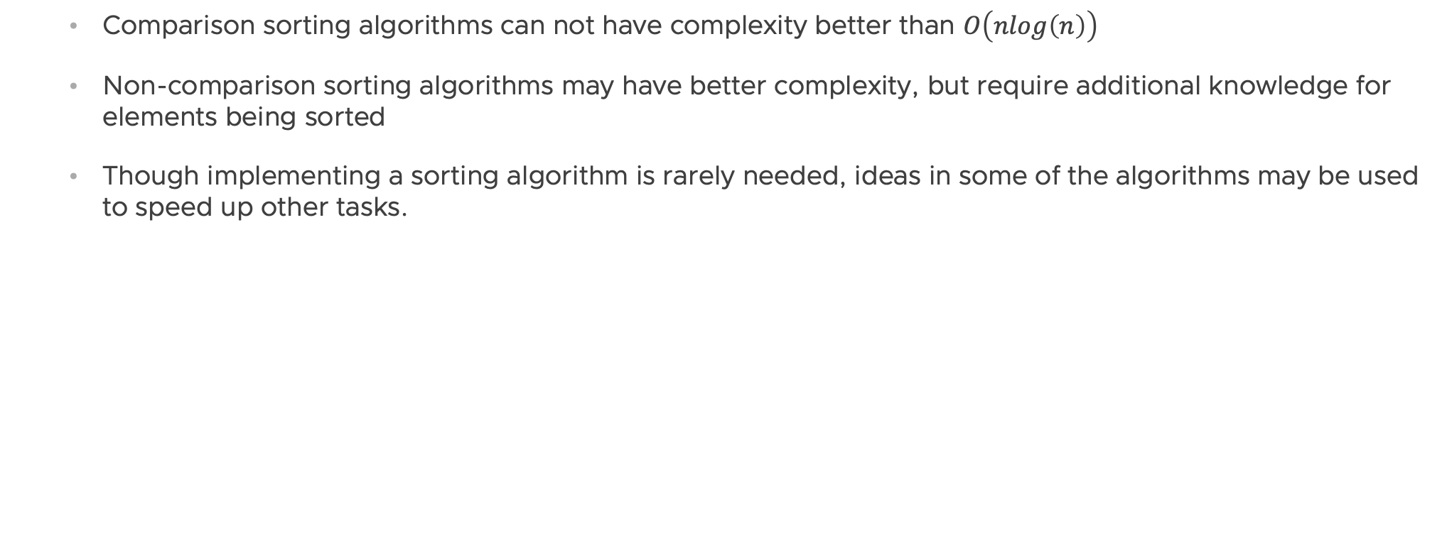
Conclusion
Comparison sorting algorithms can not have complexity better than $O\left(nlog\left(n\right)\right)$
Non-comparison sorting algorithms may have better complexity, but require additional knowledge for elements being sorted
Though implementing a sorting algorithm is rarely needed, ideas in some of the algorithms may be used to speed up other tasks.

Slide 35
Interesting
Check java sorting implementations.
Check comparators.

Slide 36
Exercise
Implement Merge sort for LinkedList.

Slide 37
Please email any questions to chaushevd@vmware.com

Slide 38
Homework
(optional)
Implement all the sorting algorithms, mentioned in this presentation:
Selection sort
Bubble sort
Insertion sort
Merge sort
Quick sort
Counting sort
Read about and implement Heap sort using array.

